Slide 1
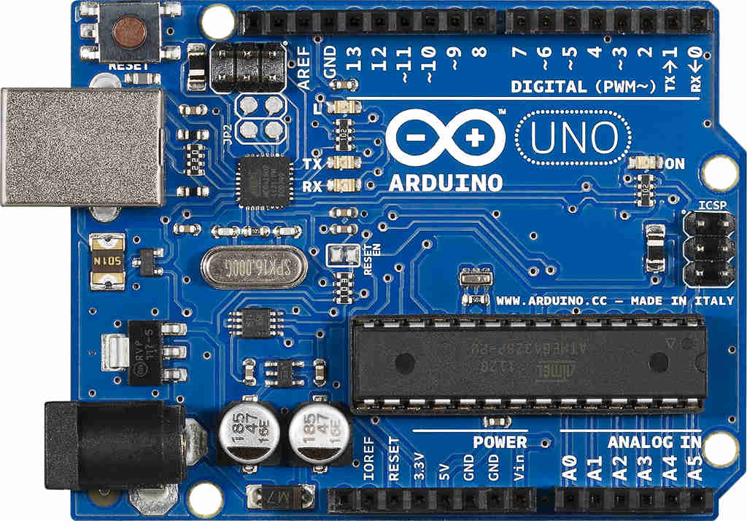
How to create an AND logic circuit using the Arduino UNO microcontroller?

Slide 2
Arduino is an open-source platform for building electronics projects. It consists of an open source hardware called Arduino board
and an Integrated Development Environment (IDE) software to write the MCU control code in a simplified version of C++, then compile and upload the code to the board.

Slide 3
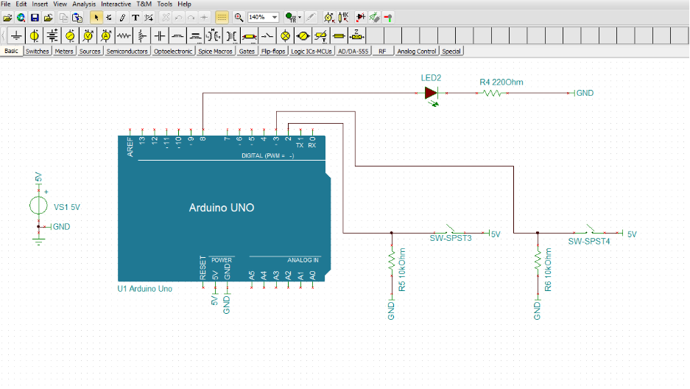
You can simulate, debug and bring your design to life in a mixed circuit environment before uploading it to the board.
TINA and TINACloud provide an extensive support for Arduino.

Slide 4
Now let's see the steps of creating an AND logic circuit using the Arduino UNO microcontroller.
First download & install the latest Arduino program from the Arduino website:
https://www.arduino.cc/en/Main/Software

Slide 5
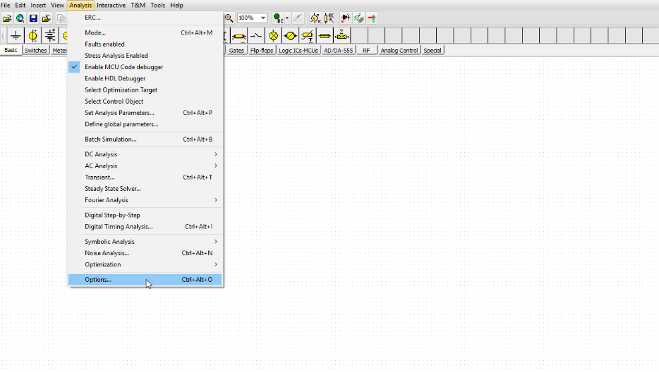
Set the Arduino path in TINA as follows before using Arduino for the first time.
Click on the Analysis menu on the Toolbar &
Select Options...

Slide 6
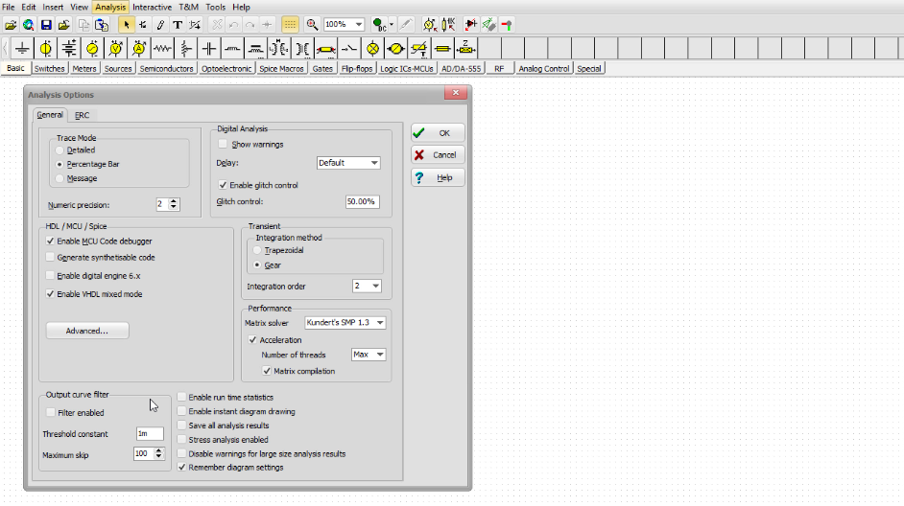
Press the Advanced... Button in the Analysis Options Window

Slide 7
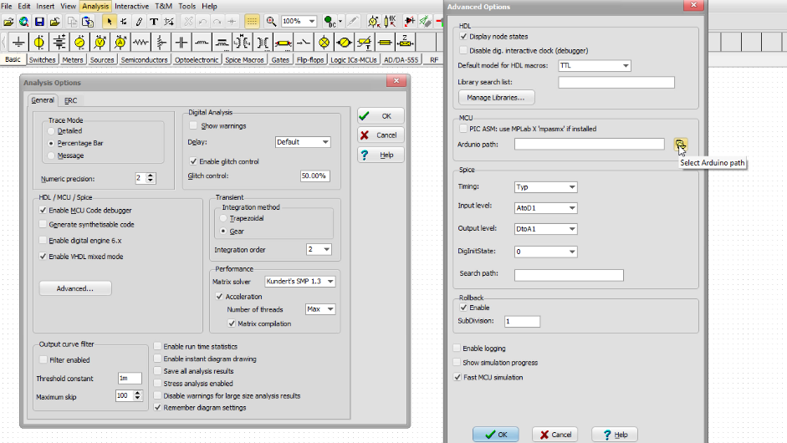
Next, click the "Select Arduino path" button in the
Advanced Options Window

Slide 8
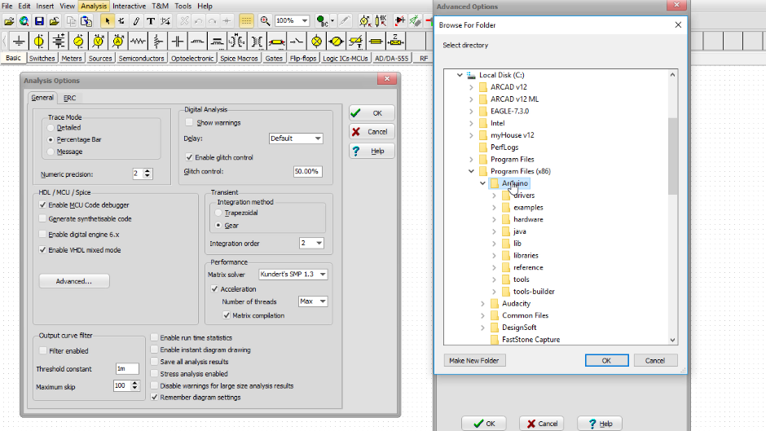
and select Arduino
(in our case: C:\Program Files (x86)\Arduino)
Press the OK button

Slide 9
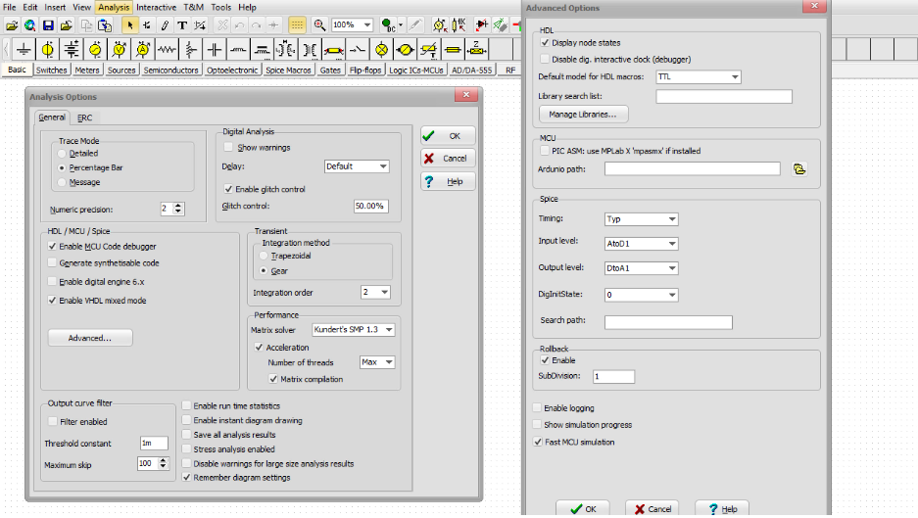
Press OK again to close the Advanced Options Display window

Slide 10
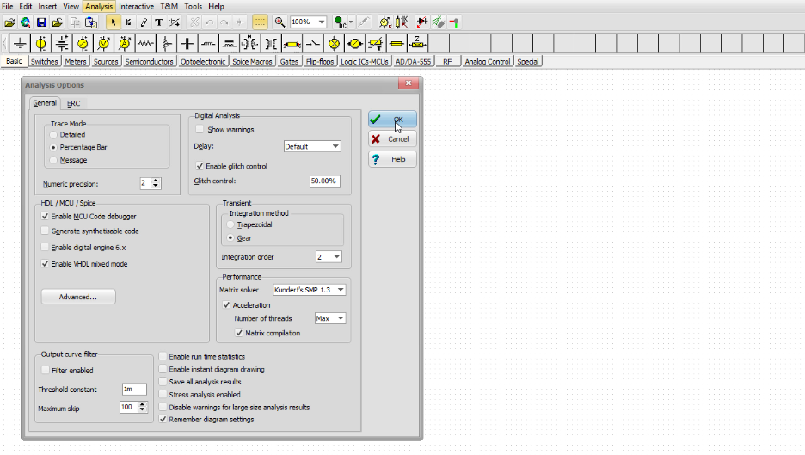
Now click OK to close the Analysis Options Window

Slide 11
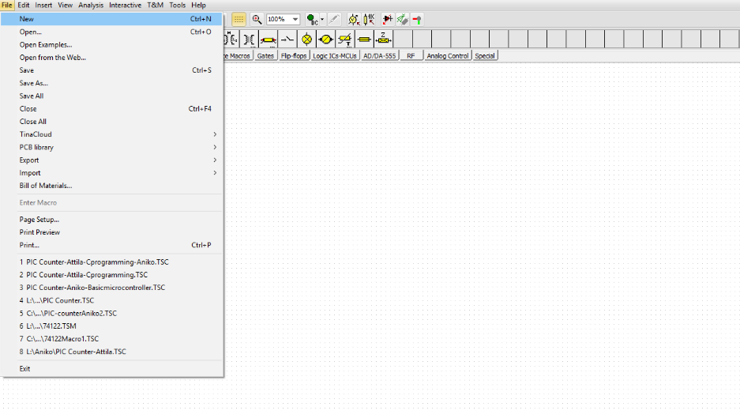
Click the File menu then select New
Now lets create a new schematic diagram.

Slide 12
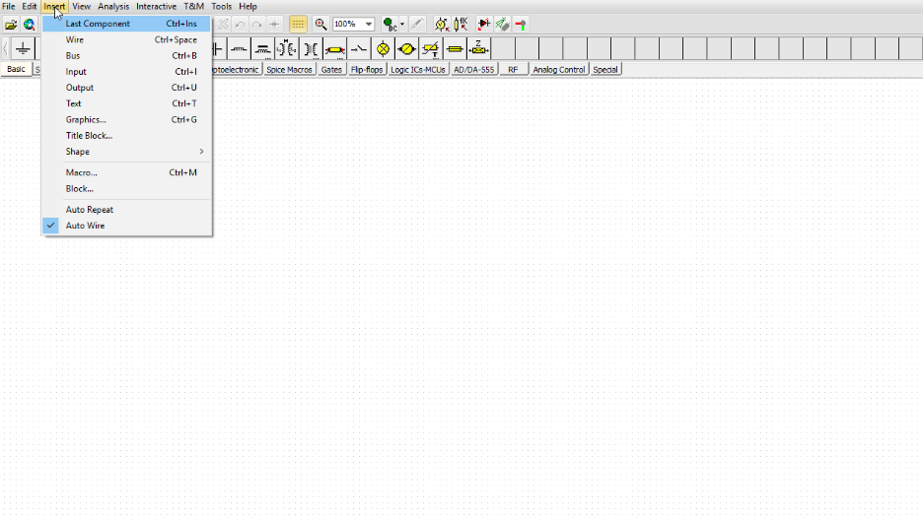
Select the “Insert” menu.
Select Macro...

Slide 13
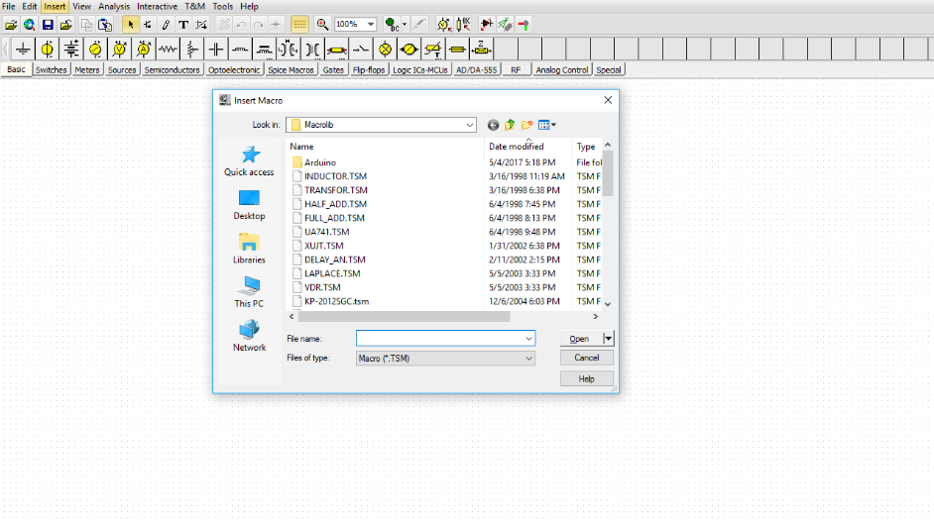
Select the Macrolib folder of TINA and double-click the Arduino folder

Slide 14
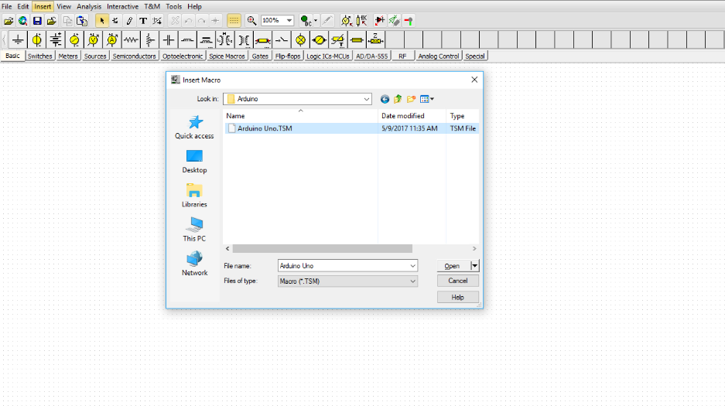
Open the Arduino Uno.TSM

Slide 15
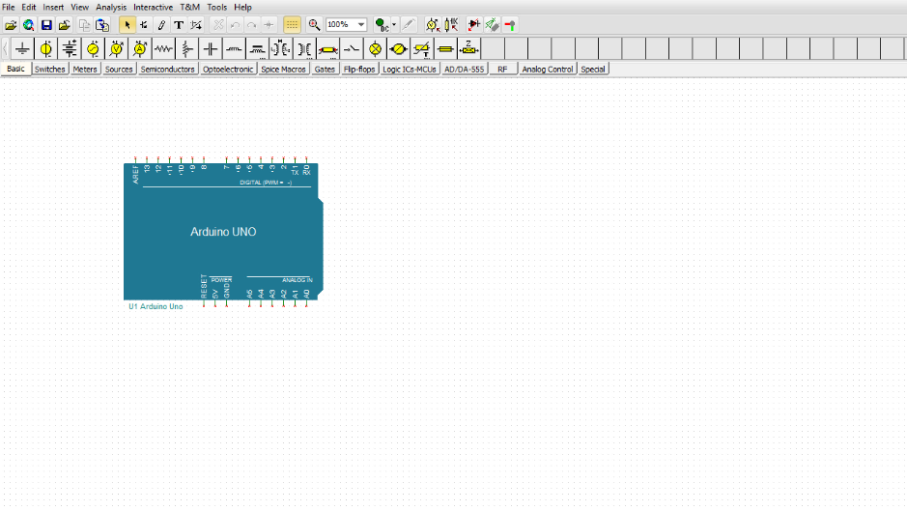
The Macro will be attached to your cursor, you can place it wherever you wish on the workspace.

Slide 16
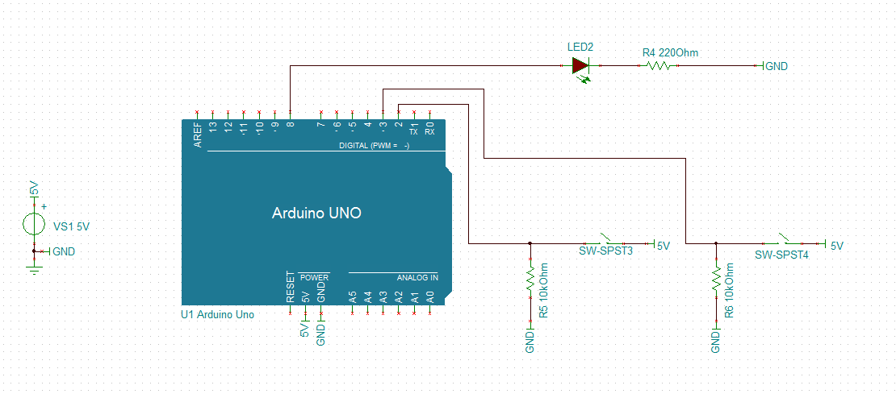
Let’s create the following circuit:

Slide 17
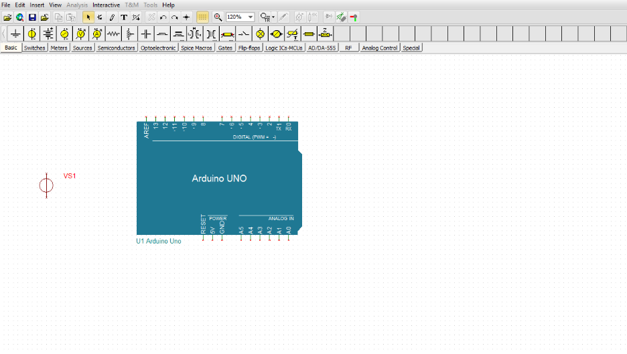
Select a “Voltage Source” from the “Basic” Toolbar and place it on the workspace.

Slide 18
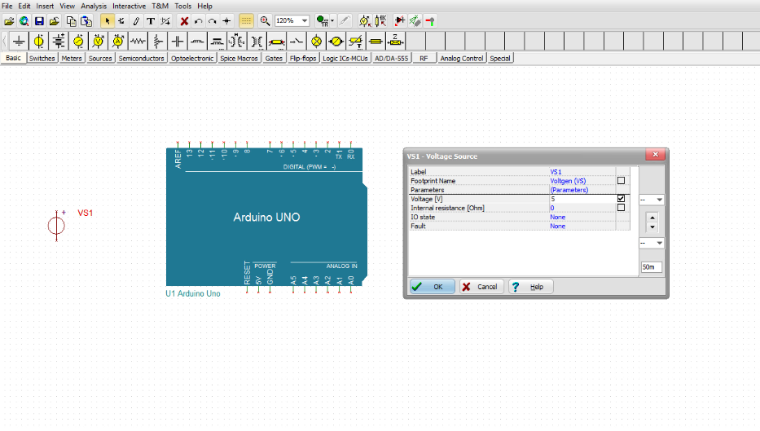
Set its “Voltage” parameter to 5V.

Slide 19
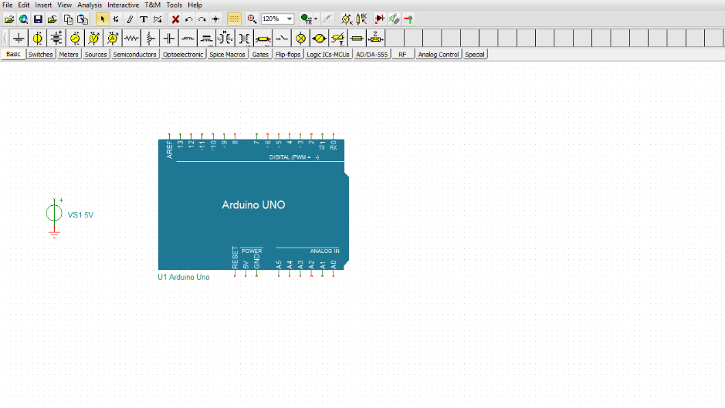
Select and place a Ground from the “Basic” Toolbar.

Slide 20
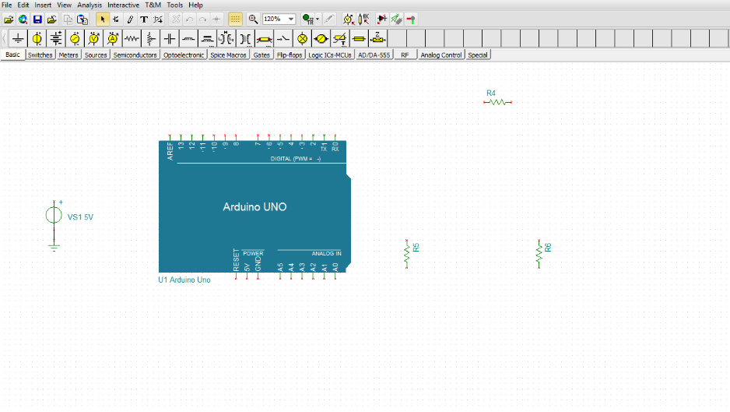
Next, select and place 3 Resistors

Slide 21
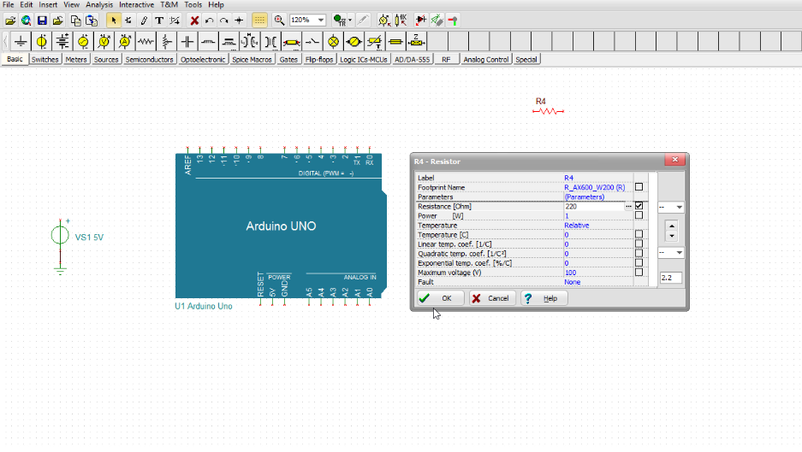
Double-click the Resistors and set their
“Resistance” values to 220, 10K and 10K.

Slide 22
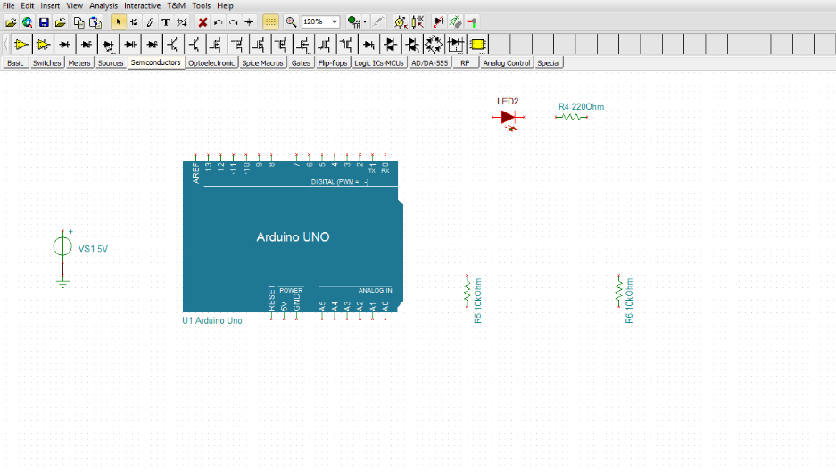
Select and place an “LED” from the “Semiconductors” Toolbar.

Slide 23
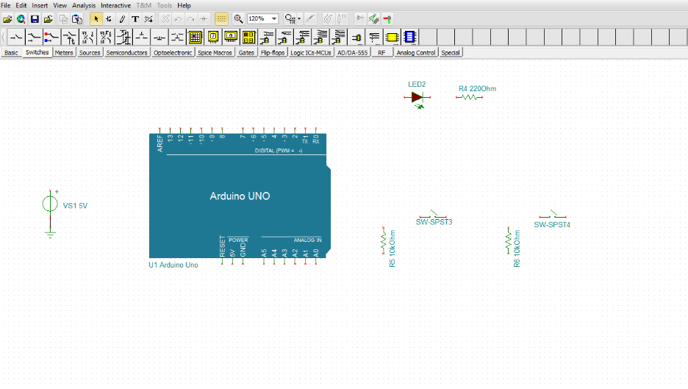
Select and place 2 Switches from the “Switches” Toolbar.

Slide 24
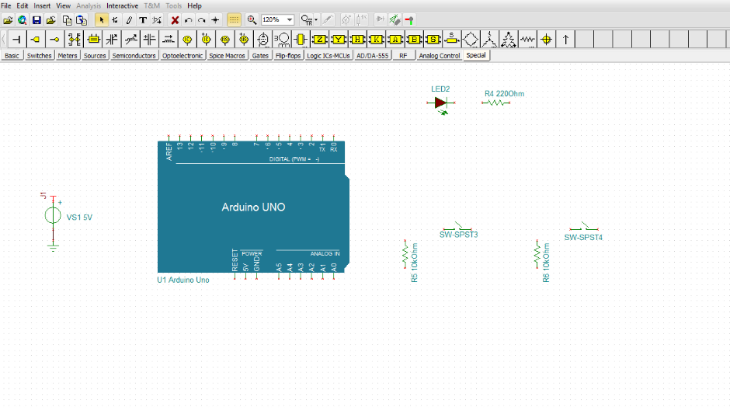
Select and place 4 Jumpers from the “Special” Toolbar

Slide 25
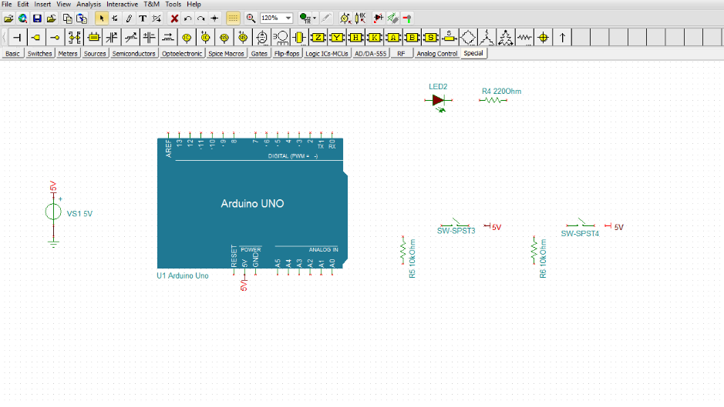
and change their labels to 5V.

Slide 26
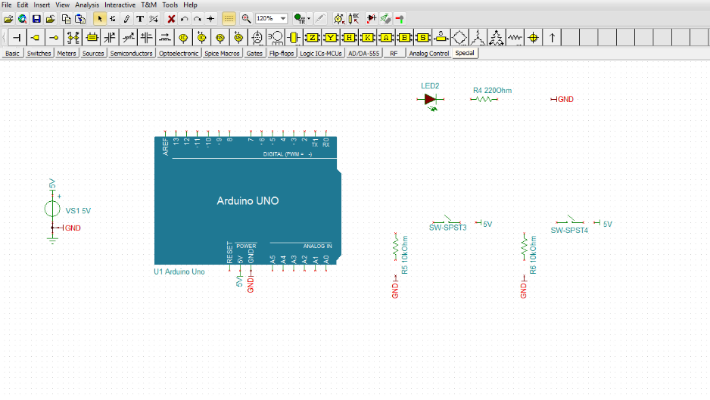
then select and place 5 more jumpers & change their labels to GND.

Slide 27
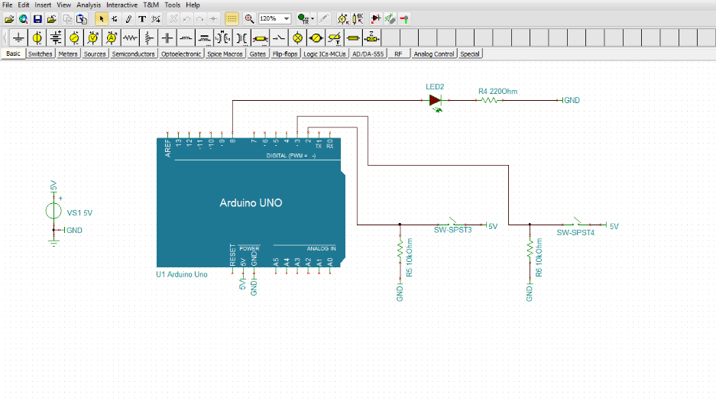
Finally connect the components.

Slide 28
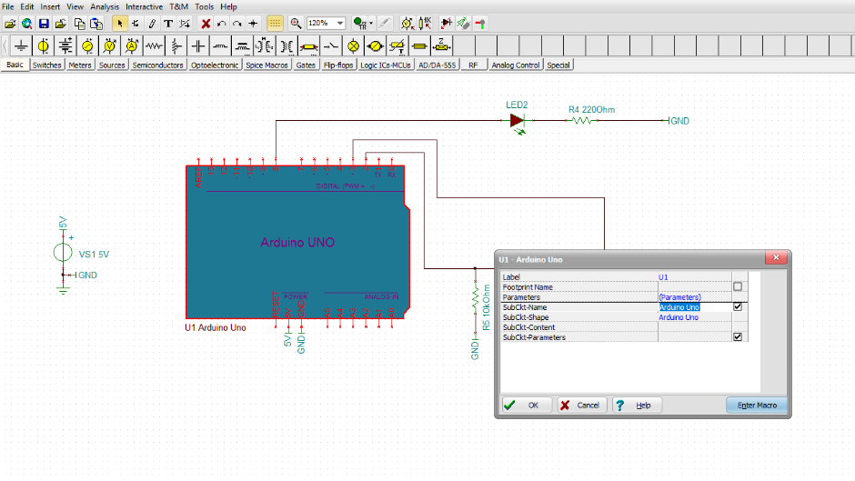
Load the controlling program into the microcontroller
Double-click on the Arduino UNO, then press the “Enter Macro” button.

Slide 29
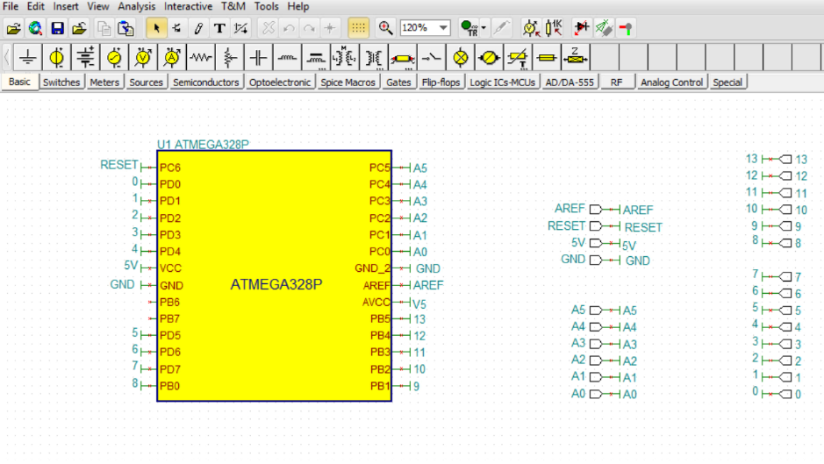
The ATMEGA328P MCU used in Aurdino UNO appears

Slide 30
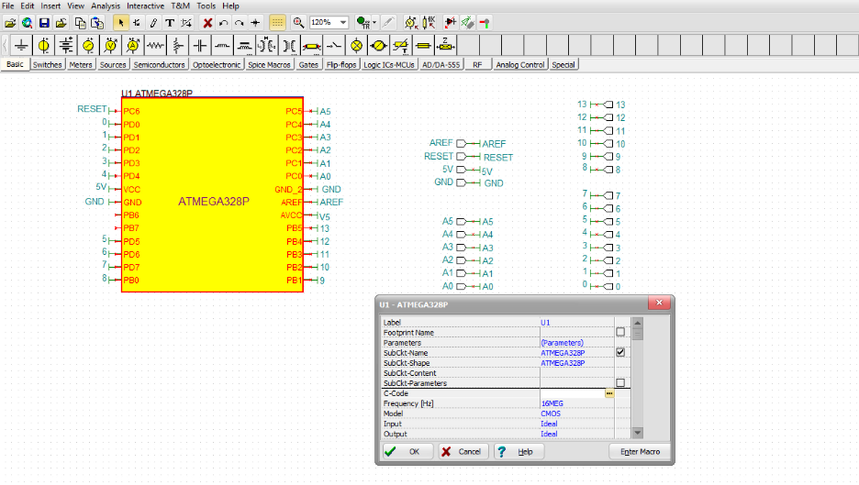
Click the 3 dots button in the “C-code” field

Slide 31
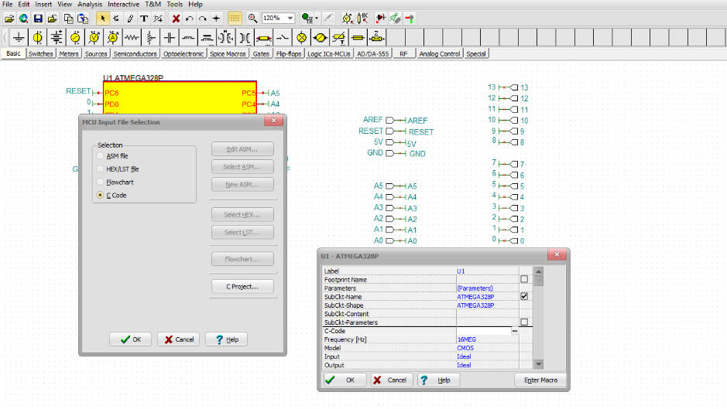
Next, click the “C Code” in the MCU Input File Selection window

Slide 32
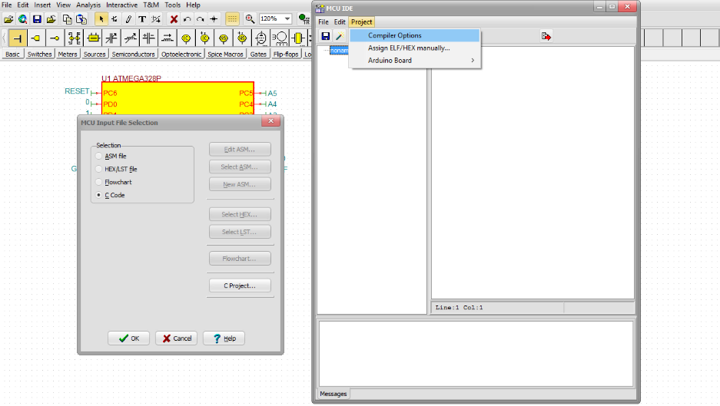
Click the “Project” button in the MCU IDE window and select Compiler Options.

Slide 33
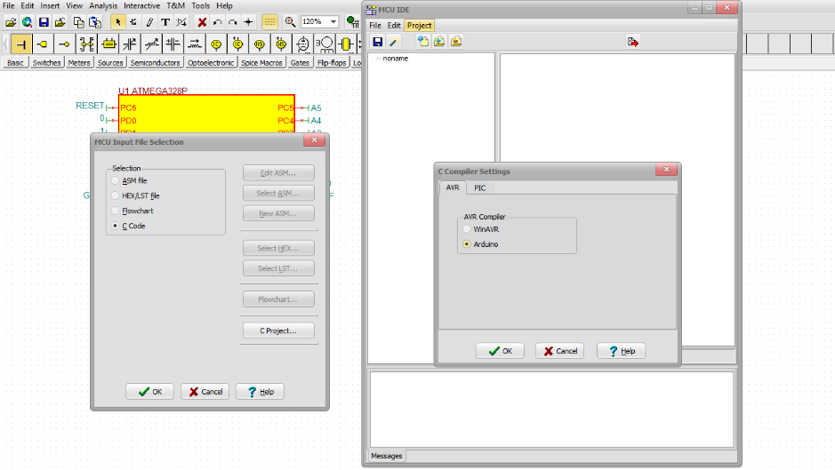
In the C Compiler Settings window make sure Arduino....is selected.
then Click OK

Slide 34
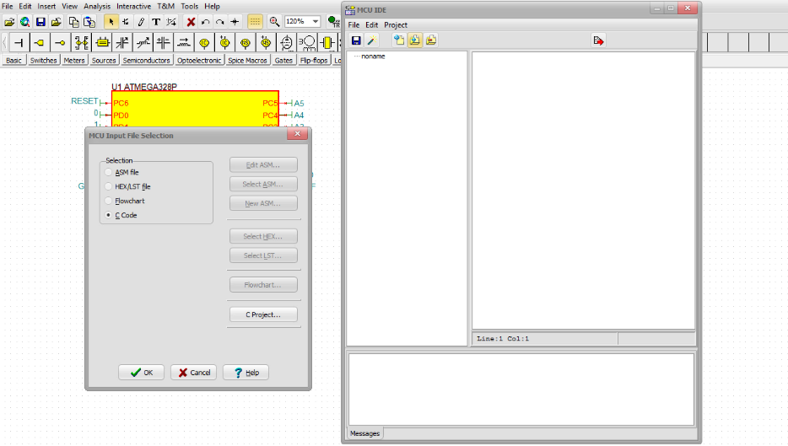
Click the "Add existing file to Project" icon in the MCU IDE window.

Slide 35
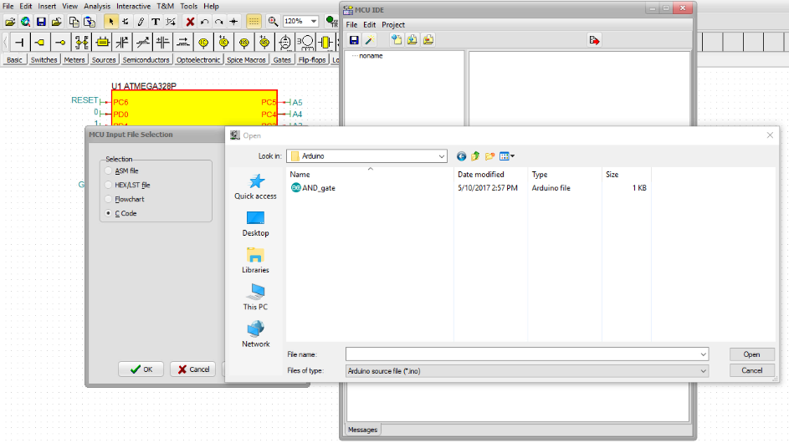
Select the AND_gate.ino file, then click Open.

Slide 36
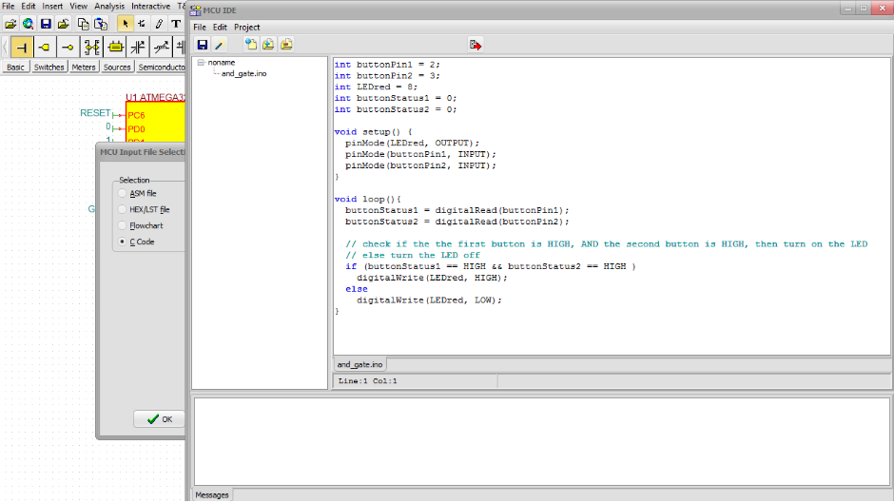
Next click on the "Make Project" button.

Slide 37
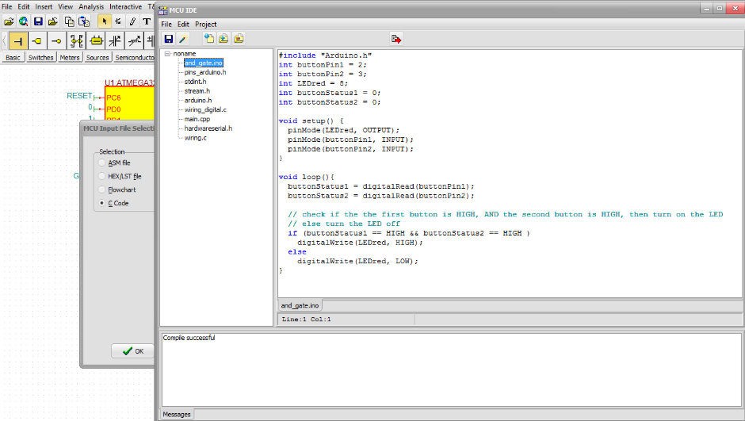
Close the MCU IDE window,
press the "Save Project" button.
When the "Compile succesful" message appears,

Slide 38
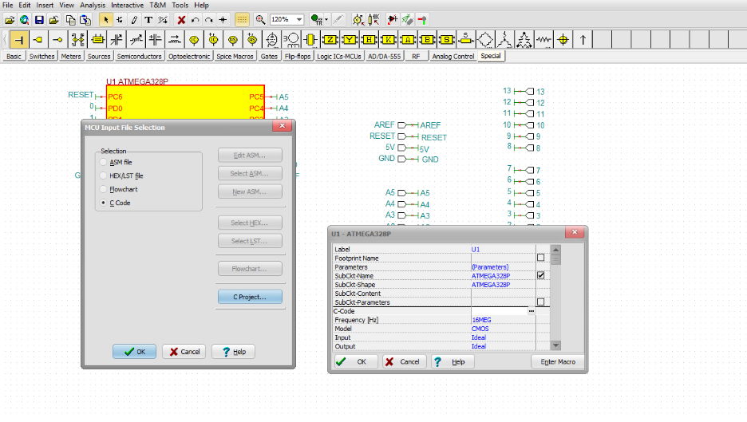
then press “OK” to close the MCU Input File Selection window as well.

Slide 39
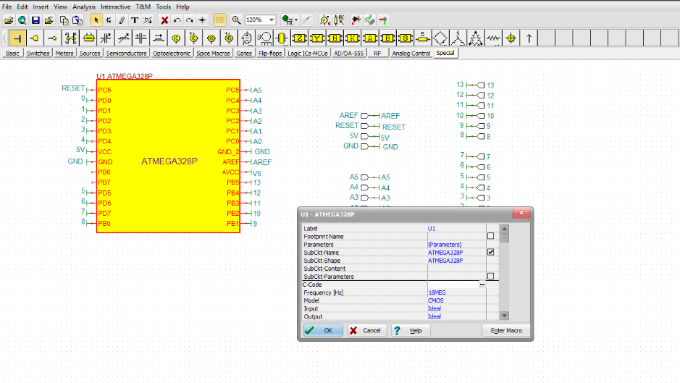
Click OK to close the “Enter Macro”window.

Slide 40
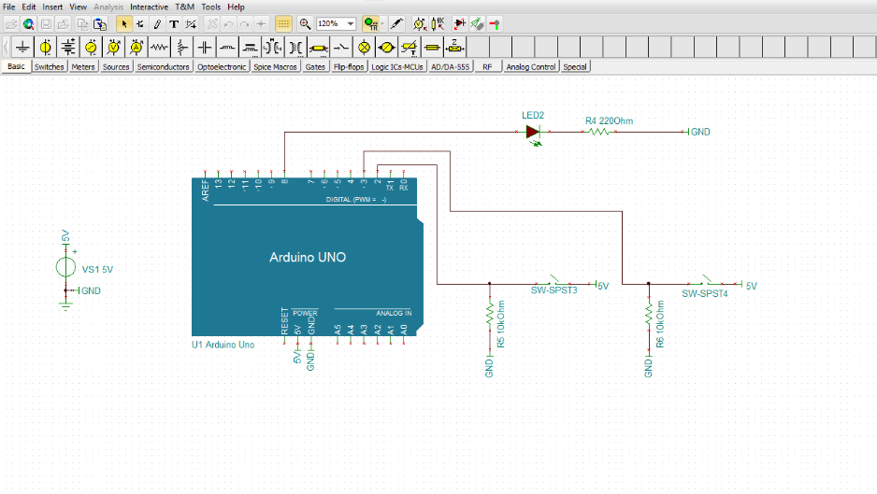
Click the left (SPST3) and right (SPST4) switches to close both switches.
Finally press the “TR” button to start the Interactive Simulation.

Slide 41
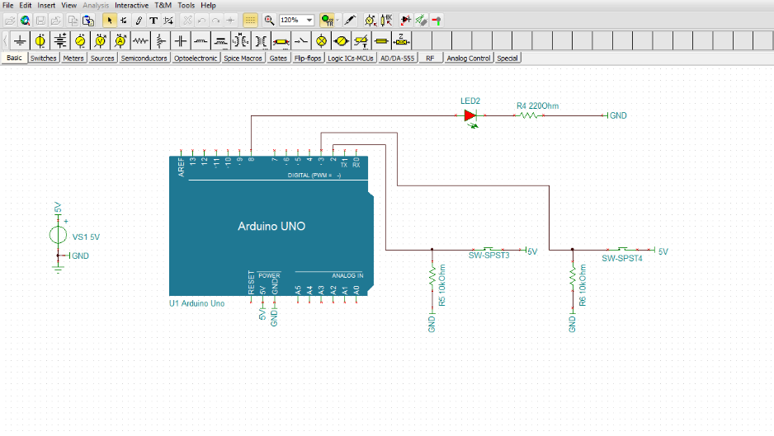
When both switches are closed, the LED lights up.

Slide 42
For more information visit our website at
www.tina.com
www.tinacloud.com
Visit our YouTube channel at
https://www.youtube.com/user/TinaDesignSuite

